Slide 1



Course Project 2: Microbiome data analysis of Zygnema green algae
Dr. Xuehuan Feng(Postdoc)
Xinpeng Zhang (PhD student)
Yi Xing (Master student)
Department of Food Science and Technology
11/21/2024
PI: Yanbin Yin

Slide 2
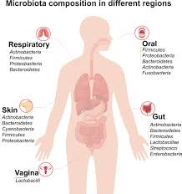
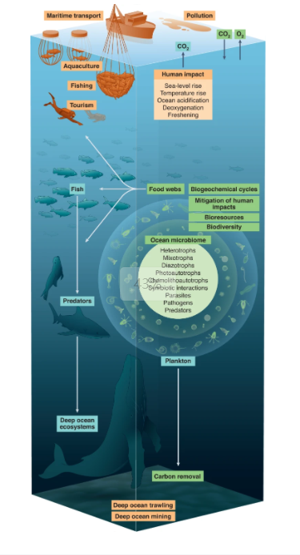
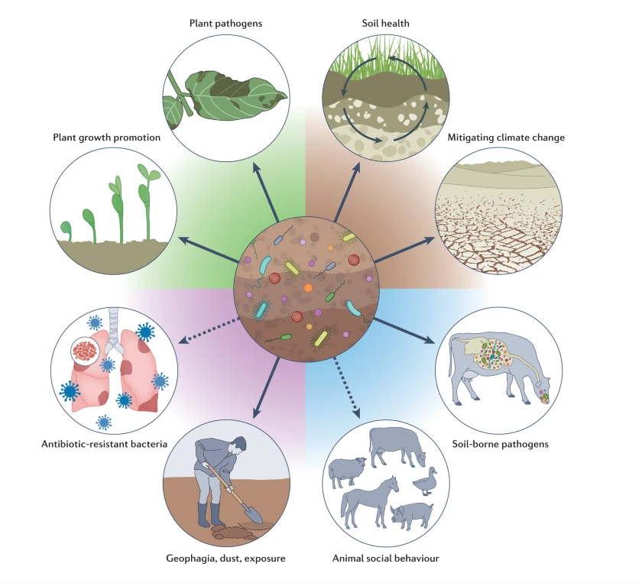
Background - What is Microbiome?
Microbiota describes the living microorganisms (bacteria, archaea, protists, fungi, and viruses) found in a defined environment.
Microbiome refers to the collection of genomes from all the microorganisms (such as fungi, bacteria and viruses) in the environment.
Linving on, in and around people, plants, animals, soil, oceans and the atmosphere.
https://doi.org/10.1038/s41392-022-00974-4
https://doi.org/10.1038/s41579-022-00779-w
https://doi.org/10.1038/s41564-022-01145-5
Notes:
The term “microbiome” is shorthand for the vast and still largely unexplored worlds of bacteria, viruses, fungi and other microorganisms that inhabit every corner of the planet.

Slide 3
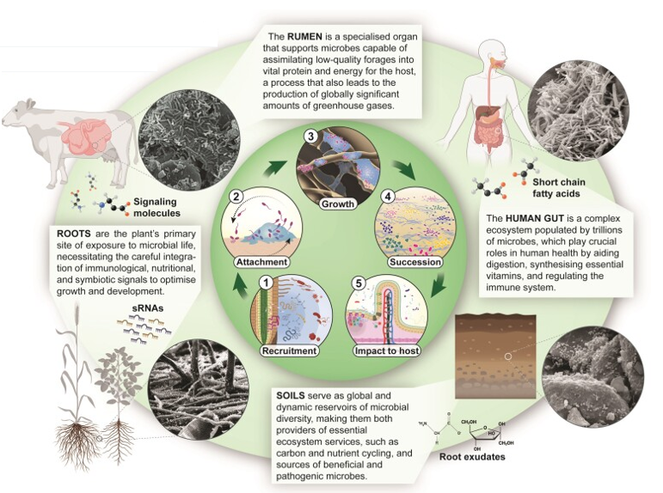
Background - The Importance of Microbiome
Microbiomes are foundational components of the environment that provide essential services relating to
food security
carbon sequestration
human health
overall well-being of ecosystems
Microbiota exert their effects primarily through complex interactions at interfaces with their plant, animal, and human hosts, as well as within the soil environment.
https://doi.org/10.1093/femsre/fuae008

Slide 4
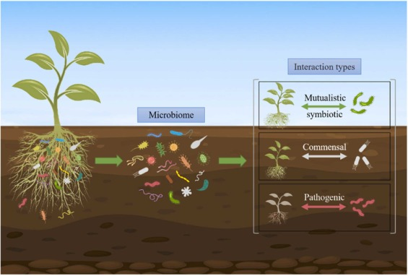
Background - Plant-microbe interactions
The members of a plant microbiota comprise beneficial, neutral and pathogenic microorganisms.
Beneficial microbes
mutualistic symbiotic relationships with plants
promoting plant nutrient uptake and growth
Ex: the nodulation recognition system in legumes
Neutral microbes
one-sided benefit:
one partner benefits, while the other is unaffected
no direct impact:
do not directly benefit or harm plants
indirect influence:
affect plants through interactions with other microbes
https://www.sciencedirect.com/science/article/pii/S2949952623000043#fig0005
Pathogenic microbes
impair plant physiological processes, biochemical pathways, and growth

Slide 5
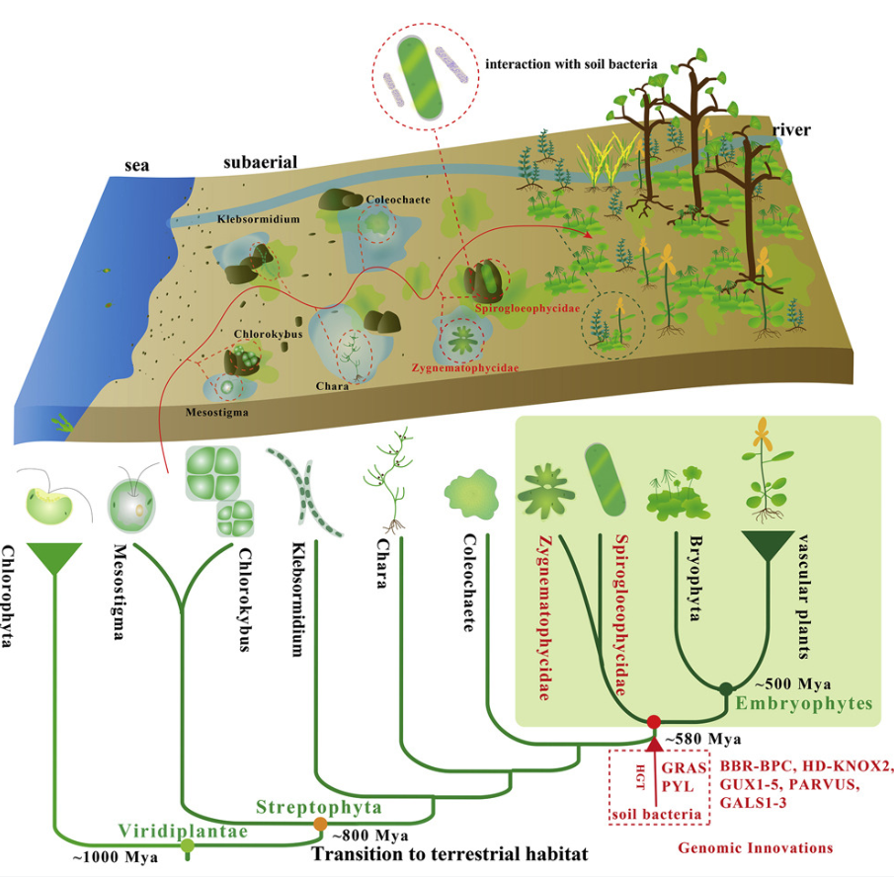
Background - Why Study the Microbiome of Zygnema Green Algae?
Microbiomes are critical for ecosystem health, influencing nutrient cycling, stress tolerance, and evolution.
Land plants evolved from aquatic algae ~600 million years ago, relying on microbes for terrestrial adaptation.
Zygnema, a close relative of early land plants, is an untapped resource for understanding plant-microbe co-evolution.
No Zygnema microbiome data exists, making this research a novel contribution to the field.
Aquatic
Terrestrial
https://www.sciencedirect.com/science/article/pii/S0092867419311699#abs0015

Slide 6
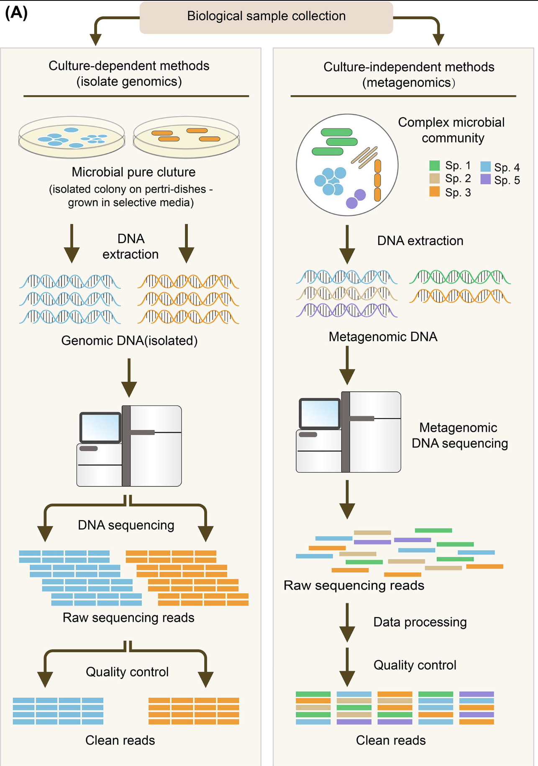
Background - Metagenomics: Overcoming the Limits of Culturing Microorganisms
One of the big questions in studying the microbiome is:
Many microorganisms cannot be cultured for the time being.
To fix this problem, metagenomics are developed:
Metagenomics is the study of the structure and function of entire nucleotide sequences isolated and analyzed from all the organisms (typically microbes) in a bulk sample.
https://www.sciencedirect.com/science/article/pii/S2001037021004931

Slide 7
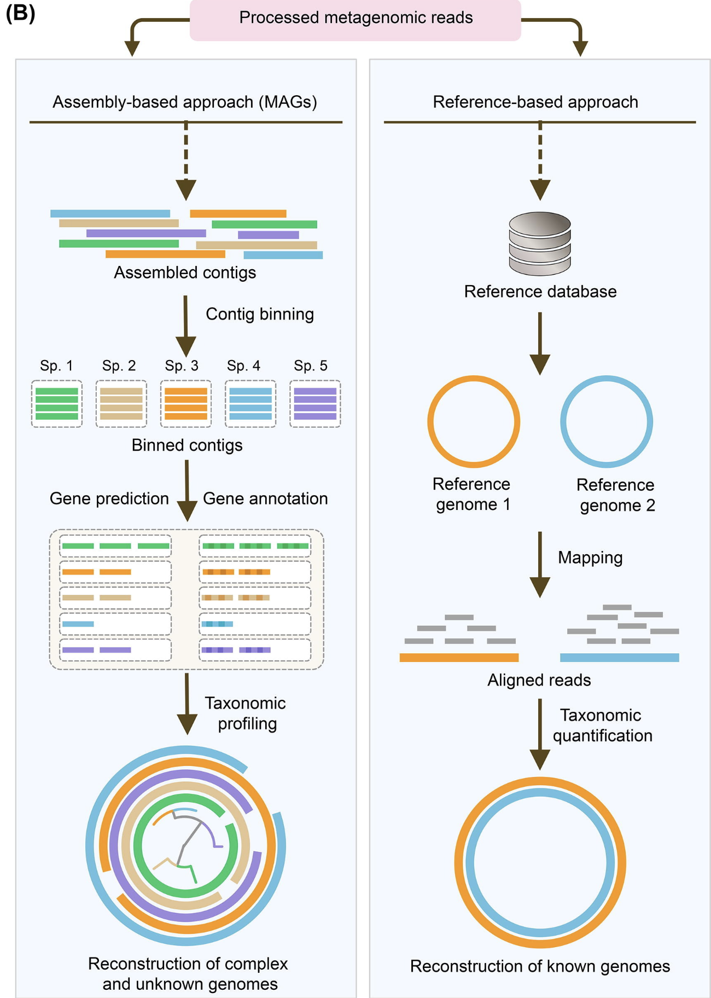
Background - Comparison of Assembly-Based and Reference-Based Metagenomic Approaches
On the left, raw reads are assembled by assembling them to form short contigs, which are then merged into larger bins based on different methods, and each bin is a genome, called Metagenome-Assembled Genomes (MAGs).
On the right is a traditional method, by mapping raw reads with reference genomes (golden standards) obtained by other methods, and eventually reconstructing them into genomes based on the reference genome.
https://www.sciencedirect.com/science/article/pii/S2001037021004931

Slide 8
Justification
There are many reports on the interaction between land plants and microbes, but there are still much unknown about the relations between algae and microbes. Question? 1. How the bacteria facilitate the algae adapt the land environment? 2. Can bacteria help the algae against pathogens? 3. Can bacteria induce the signaling transduction of the algae to response to environmental stress? 4. Can bacteria produce chemicals to protect them from stress, such as cold stress? (directly or indirectly protect the algae.) What are the pathways involved in the responses?

Slide 9
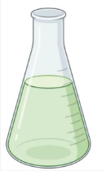





Workflow for Microbiome Data Analysis of Zygnema circumcarinatum MZCH241
Data preparation
MZCH241 microbiome (Algae & bacteria)
Data prepprocessing
Illumina sequencing of the MZCH241
Total reads
Bacteria fungi reads
Remove host reads
Taxonomy, Gene prediction & functional annotation
Assembly
Binning

Slide 10
Recourse information
Pre-installed programs on hcc: https://hcc.unl.edu/docs/applications/modules/
Conda/mamba:
https://docs.conda.io/en/latest/
https://github.com/mamba-org/mamba Conda/mamba is an python package and environment management system that runs on Windows, macOS, and Linux. Could create individual environments to avoid the program conflicts.
Mamba is much faster than conda sometimes.
A protocol command file has all details and commands.

Slide 11
Reminder before starting
For each step, create a folder with partN_name.
When you finish one part, remember to "module unload current_program" to avoid the program conflicts.
Do not forget where you are at, and the file path.
Do not run huge jobs directly on login node. Run it by submitting slurm scripts.
Do not forget to revise the slurm scripts to use your own path (err, out, input_file, etc.)
Read your error and output files for trouble shooting.
All commands and scripts are in a protocol command file.
Do it as soon as possible because you may need to wait for a longer time as HCC is busier at the end of the semester.

Slide 12
Overview
In this project, we will learn how to do a complete metagenomic analysis, from raw reads to the gene annotations.
We’ll use algae microbiome as an example, and this protocol could be applied to other microbiome data.
We’ll provided you the metagenomic sequencing data(pair-end reads), including the algae genome and microbiome.

Slide 13
Part 0 Data preparation

Slide 14
Zygnema circumcarinatum MZCH241
MZCH-SVCK (University of Hamburg, Germany)
Microalgae and Zygnematophyceae Collection Hamburg
https://www.nature.com/articles/s41588-024-01737-3

Slide 15
0.1 - Preparing Your Workspace for Metagenomic Data Analysis
In this project, we'll work on illumina pair-end metagenomic sequencing data of algae (Zygnematophyceae). It contains two raw read files: fastq1 and fastq2.
The data consists of reads from both (host) algae and microbiome. We'll remove the algae data first and then focus on analyzing the microbiome data.
Create a folder for this part.
Copy the data to your work folder.
cd $WORK
mkdir final_project
cd final_project
cp -r /work/yinlab/yixing/course_project2/project_raw_data .

Slide 16
Part I Data preprocessing (~2 hrs)

Slide 17
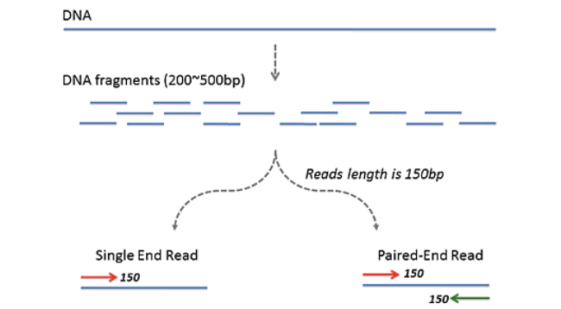
1.1 - Quality Control in Paired-End Next-Generation Sequencing (NGS)
Next-generation sequencing(NGS) usually uses paired-ended sequencing, meaning that it is sequenced from two directions and ends up with two sequencing files, one forward and one reverse.
We need to check the quality of sequencing data, such as low-quality reads and regions, contamination or technical deviations.
By examining metrics such as sequence quality scores, sequence length distributions, GC content, repeat sequences, and k-mer content.

Slide 18
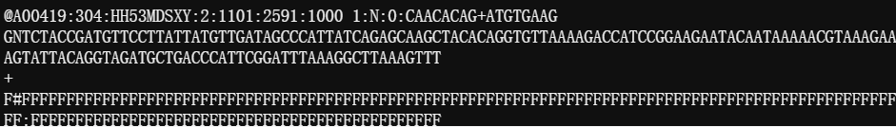
1.1 - Quality Control
FASTQ File Format
First line: identifier and description (starts with @).
Second line: sequence (nucleotide sequence).
Third line: separator (starts with + acts as a divider between the sequence (second line) and its quality scores (fourth line)).
Fourth line: base quality scores (corresponds to the sequence in the second line).

Slide 19
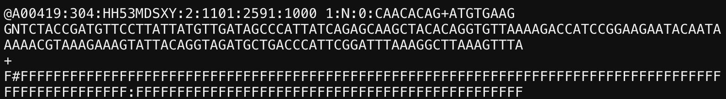
1.1 - Quality Control
We'll use "FastQC" to check the quality of fastq file
mkdir part1_data_preprocessing
cd part1_data_preprocessing
mkdir prefastqc
cd prefastqc
ml fastqc
fastqc ../../project_raw_data/MZCH241_bacteria.R_1.fastq --outdir .
fastqc ../../project_raw_data/MZCH241_bacteria.R_2.fastq --outdir .

Slide 20
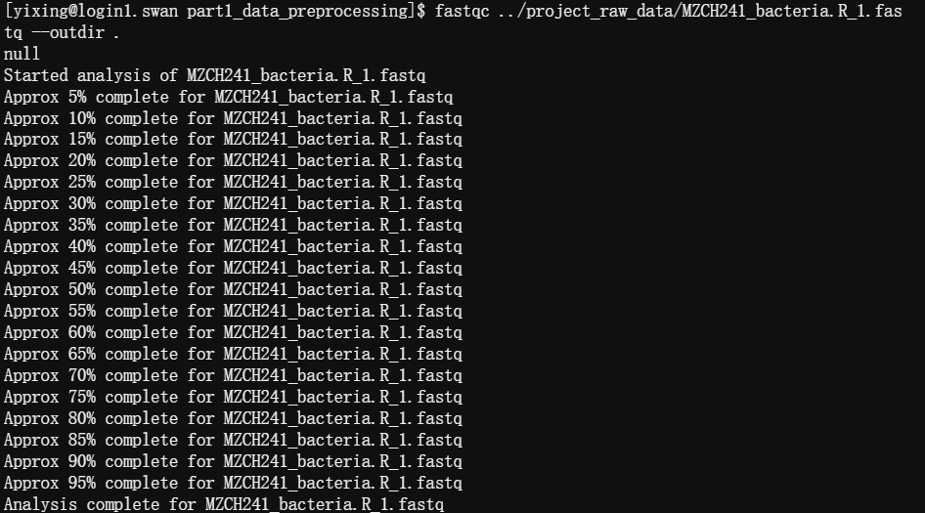
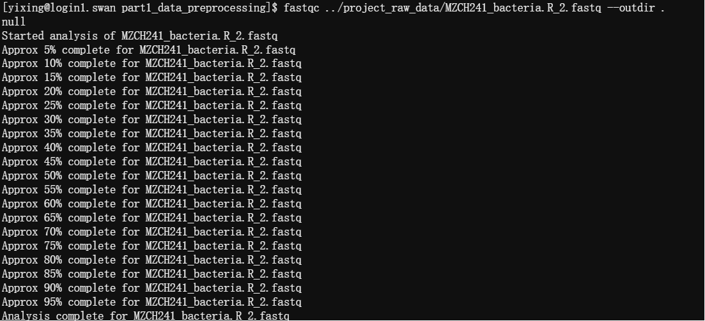
1.1 - Quality Control
We'll use "FastQC" to check the quality of fastq file
mkdir part1_data_preprocessing
cd part1_data_preprocessing
mkdir prefastqc
cd prefastqc
ml fastqc
fastqc ../../project_raw_data/MZCH241_bacteria.R_1.fastq --outdir .
fastqc ../../project_raw_data/MZCH241_bacteria.R_2.fastq --outdir .

Slide 21
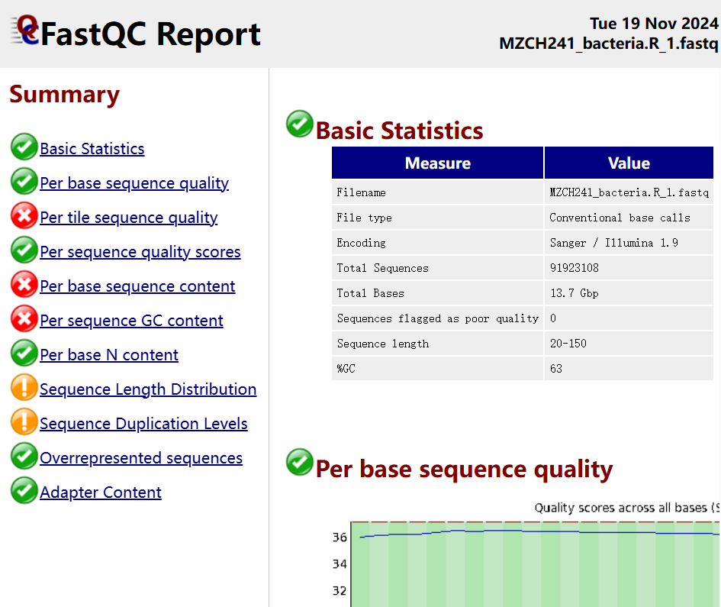
1.2 - Interpreting FastQC Results for Quality Assessment
After running fastqc, we will get a batch of results including a html file.
Download and read it.
In your report, you need to explain the meaning of each plot.

Slide 22
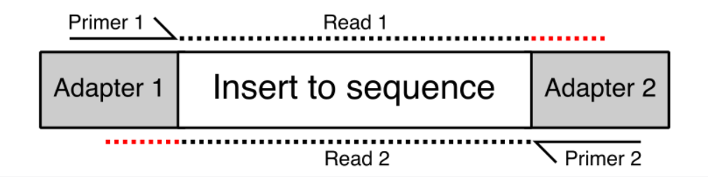
1.3 - Trimming Low-Quality Reads and Adapters with Trim Galore
Adapters are Required for Sequencing:
Many sequencing platforms require adapter sequences to provide anchorage and priming points for sequencing reactions.
Adapters Can Contaminate Reads:
When insert lengths are shorter than the sequencing read length, the sequencing may run into adapter sequences at the ends of reads.
Unwanted Adapter Sequences:
Read-through adapters can lead to non-native sequences being included in the reads, contaminating the data.
Inaccurate Analysis Without Trimming:
Adapter contamination can interfere with downstream analyses, such as alignment and assembly.
Solution: Trim Galore
Trimming tools like Trim Galore remove adapter sequences and low-quality bases, ensuring clean and reliable data for further analysis.
https://sequencing.qcfail.com/articles/read-through-adapters-can-appear-at-the-ends-of-sequencing-reads/

Slide 23
1.3 - Trimming Low-Quality Reads and Adapters with Trim Galore
After that, we would remove those adapters, low-quality reads and regions to avoid effecting our results, which is called "trim".
We will use "trim_galore" which is preinstalled on hcc.
https://github.com/FelixKrueger/TrimGalore
There are different parameters, but here we just run with the default
cd ..
mkdir trim
cd trim
#!/bin/bash
#SBATCH --job-name=trim
#SBATCH --time=124:00:00
#SBATCH --mem=100gb
#SBATCH --partition=batch,guest (reminder: you could add your own partition)
#SBATCH --output=trim.%J.out
#SBATCH --error=trim.%J.err
#SBATCH --ntasks=20
#SBATCH --cpus-per-task=1
module unload fastqc
module load trim_galore/0.6
trim_galore --paired your/path/of/fastq1.gz_file your/path/of/fastq2.gz_file -j 20
-j
threads: many tools could use threads to increase the speed of computing by adding the amount of cores(CPUs/GPUs).
-- Paired
input files are paired-end sequencing

Slide 24
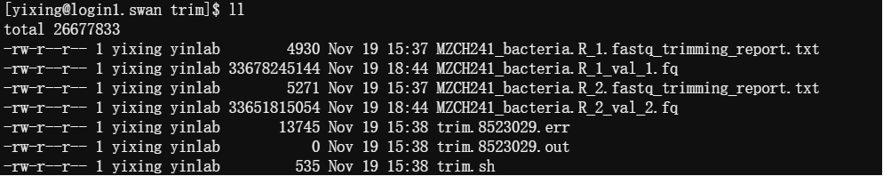
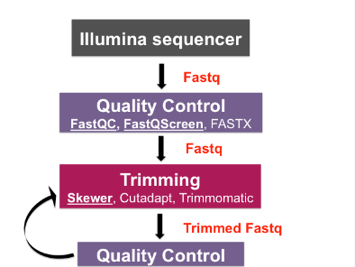
1.3 - Trimming Low-Quality Reads and Adapters with Trim Galore
Then you could get the trimmed report by trim_galore.
After that, run the fastqc again to check the difference between the raw reads and trimmed ones.
Report the difference in your report.
https://biocorecrg.github.io/PHINDaccess_RNAseq_2020/qc_trimming.html

Slide 25
Part II Remove host reads (~ 1-2 hrs)

Slide 26
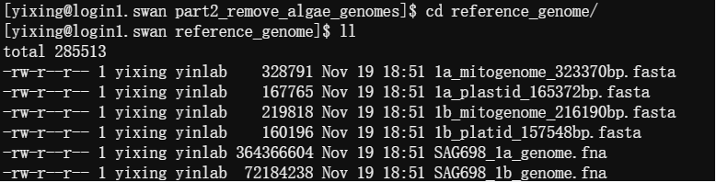
2.1 - Removing Host Contamination Using Reference Genomes
The pair-end sequencing data contains not only microbiome data, but also host data: mitochondrial, chloroplast, and algal reads, etc.
We need to remove those reads to avoid the contamination.
We will use host reference genomes to remove those reads. The reference genomes (1a and 1b are two algae, and we have their nuclear, mitogenome, and plastid genomes) are sequenced by Yin lab (paper in review at Nature Genetics).

Slide 27
2.1 - Removing Host Contamination Using Reference Genomes
We will work on the trimmed fastq files.

Slide 28
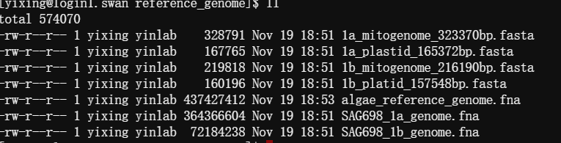
2.1 - Removing Host Contamination Using Reference Genomes
Combine all host reference genomes as one file first by "cat"
cd ../..
mkdir part2_remove_algae_genomes
cd part2_remove_algae_genomes
cp -r /work/yinlab/yixing/course_project2/project_raw_data/reference_genome .
cat * > algae_reference_genome.fna

Slide 29
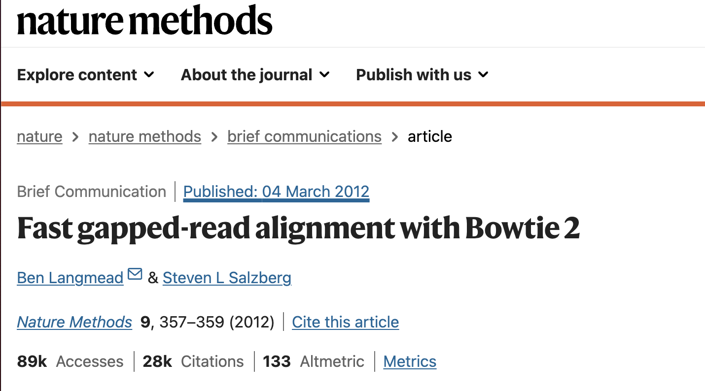
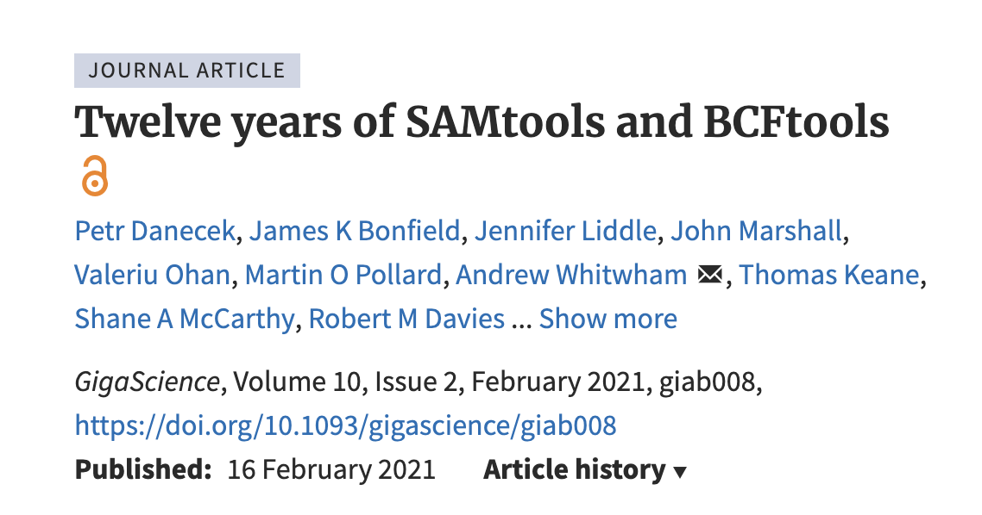
2.2 - Removing Host Reads with Bowtie2 and SAMtools
We will use "Bowtie2" and "SAMtools" to remove host reads from the sequencing data.
Those are preinstalled on hcc.
https://bowtie-bio.sourceforge.net/bowtie2/manual.shtml
http://www.htslib.org/
https://hcc.unl.edu/docs/applications/app_specific/bioinformatics_tools/alignment_tools/bowtie2/
After running this step, we'll remove all host reads in both fastq files

Slide 30
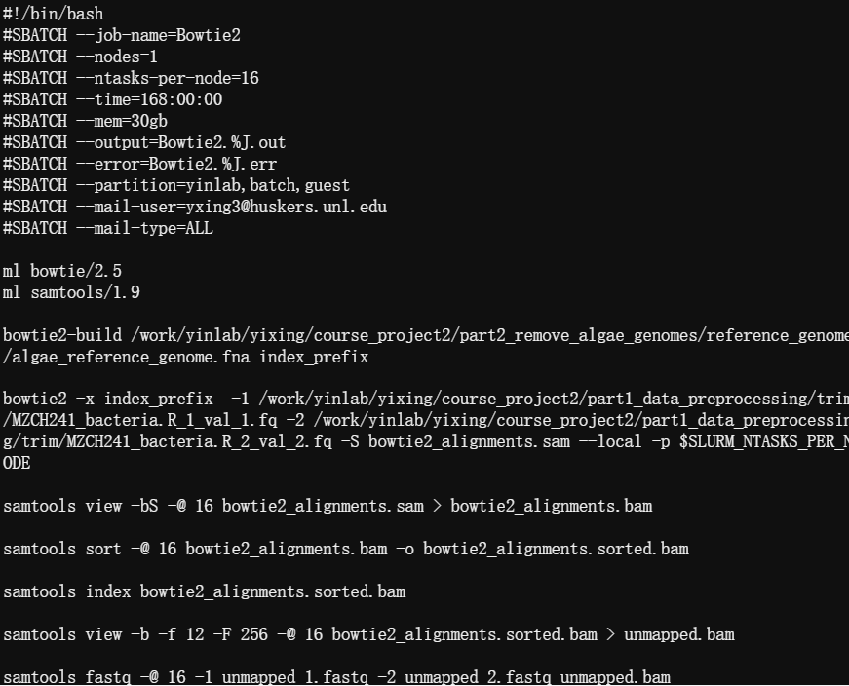
2.2 - Removing Host Reads with Bowtie2 and SAMtools
1. Here, we use BOWTIE2 to create the index of reference genome.
2. Then use it to do the alignment two fastq files with reference genome to create the SAM file.
3. Compressed it by SAMTOOLS, create the index which could increase the speed of searching.
4. And extract those unmapped reads (only keep those reads not mapped on both paired files).
5. Finally convert the BAM file back to two fastq files.
~45 mins
1
2
3
4
5

Slide 31
2.2 - Removing Host Reads with Bowtie2 and SAMtools
SAM means “Sequence Alignment/Map format”. It is the result of alignment from fastq file.
SAM file is really large.
BAM is the compressed format of SAM, which is smaller and faster to view.

Slide 32
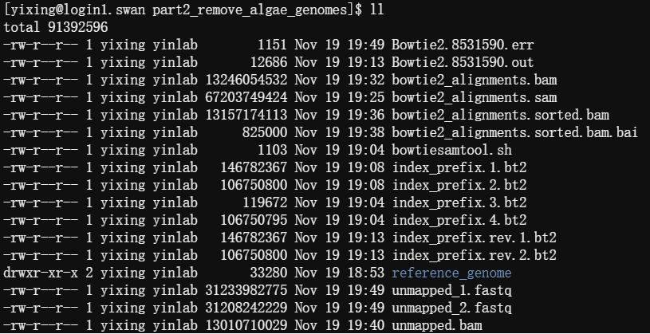
2.2 - Removing Host Reads with Bowtie2 and SAMtools
Finally you will get two fastq files.
Those are unmapped to the host, i.e., de-contaminated read file.

Slide 33
Summary
Data Preparation: Collect microbiome data (algae and bacteria) for sequencing.
Sequencing: Generate raw reads using Illumina sequencing.
Quality Control: Use tools like FastQC to evaluate raw read quality.
Trimming: Remove low-quality reads and adapter sequences using Trim Galore or similar tools.
Post-Trimming QC: Perform quality control on trimmed reads to ensure data quality.
Host Read Removal: Filter out host reads (e.g., algal DNA) using Bowtie2 and SAMtools.
Final Data: Retain high-quality bacterial and fungal reads for downstream analysis.

Slide 34
Workflow for Microbiome Data Analysis of Zygnema circumcarinatum MZCH241
Data preparation
MZCH241 microbiome (Algae & bacteria)
Data prepprocessing
Illumina sequencing of the MZCH241
Total reads
Bacteria fungi reads
Remove host reads
Taxonomy, Gene prediction & functional annotation
Assembly
Binning

Slide 35
Any questions?

